Slide 1
Supply and Demand
RSM 5010

Slide 2
Overview
Questions:
How are market prices determined?
For instance the coupons in the GM example.
What drives changes in market price?
Concepts:
Demand curve
Supply curve
Equilibrium
Shifts in supply and demand
Economic principles:
Markets bring buyers and sellers together and generate surplus for both.
What does it mean for a market to work “well”?
Notes:
Imagine a busy Saturday market. Buyers arrive with wallets; sellers arrive with goods. Prices aren’t fixed—they emerge from a tug-of-war between how much people want (demand) and how much people will bring to sell (supply). When this dance works well, both sides leave happier than they arrived—hello, surplus.

Slide 3
The demand curve
Demand curve: a representation of the relationship between the price of a good and the quantity demanded.
Price
Price on vertical axis, quantity on horizontal axis
At any given price, what quantity will consumers buy?
At price P₁, consumers are willing to buy Q₁.
At price P₂, consumers are willing to buy Q₂.
“Law of Demand”: demand curves are downward sloping.
P₂
P₁
D
Q₂
Q₁
Quantity
Notes:
You’re car-shopping. At a high sticker price, you hesitate; at a lower price, you lean in. Plot that feeling for every possible price and—boom—you’ve drawn a demand curve that slopes down because lower prices tempt more buyers.

Slide 4
Demand is a story
Demand relates prices and quantities; how many units would be purchased at a given per-unit price (quantity demanded)
As if the customer (or customers) could buy all they want at a flat, per unit price (like in the bulk food section)
The lower the price, the more people want (“Law of Demand”) (“Demand slopes down”)
Demand isn’t fixed over time; the one-percent four-percent rule could change, for GM, or it could stay the same and the quantity purchased at $20,000 could change. But demand refers to any given price-quantity relationship, fixed at some point in time
Notes:
Picture a grocery bulk bin with a simple per-unit price. Ask: “At this price, how many scoops would people take?” That whole price-quantity relationship, at a moment in time, is the story we call “demand.”

Slide 5
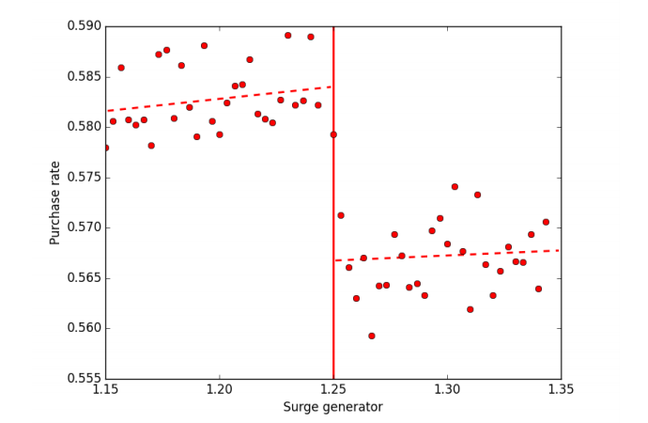
The law of demand: Uber
At the boundary, conditions are roughly held fixed, but prices are higher to the right of the boundary
A measure of demand conditions
Notes:
It’s raining, concerts just ended, and everyone opens the ride app. When the price surges, some riders tap out; when the price drops, they flood back. Same city, same night—different willingness to ride as price moves.

Slide 6
Demand: other factors
Quantity demanded depends on other factors besides price:
Consumer tastes
Prices of substitutes or complements
Demographics (population, income, etc.)
Advertising
…
A demand curve describes the relationship between price and quantity demanded when all other factors are held constant.
If some other factors change, the demand curve will shift.
Notes:
GM raises its price: you slide along the same demand curve (you buy less just because it’s pricier). But if a safety scare hits or Ford drops its price, the whole curve shifts left—suddenly, even at last week’s price, fewer people want GM.

Slide 7
Demand: other factors
Suppose D₁ is the initial demand curve for GM trucks.
What happens if GM raises its price from P₁ to P₂?
What if people discover GM trucks have a fire risk?
What if the price of Ford trucks goes down?
Price
Crucial to distinguish between:
Changes in quantity demanded (movements along the demand curve when price changes)
Changes in demand (shifts in the curve itself when other factors change)
D₂
D₁
E₃
E₂
P₂
P₁
E₁
Q₃
Q₂
Q₁
Quantity
E₁ → E₂: increase in price of GM trucks
E₂ → E₃: decrease in price of Ford trucks, or customers learning something bad about GM trucks
Notes:
GM raises its price: you slide along the same demand curve (you buy less just because it’s pricier). But if a safety scare hits or Ford drops its price, the whole curve shifts left—suddenly, even at last week’s price, fewer people want GM.

Slide 8
Demand Curves: Firm vs. Market vs. Individual
Firm: what is the demand for a firm’s product
i.e. iPad, GM trucks, posts on Instagram
Market: what is the demand for a variety of similar products
i.e. Tablet computers
This works best when the product is relatively homogenous (like oil), but the model works well even if the product isn’t completely homogenous.
Individual: what does a given consumer demand of a given product
How many beers would I buy at a given price?
Our GM example focused on FIRM demand. Our model of supply and demand today will use MARKET demand.
Law of demand relevant to all three.
Notes:
One person’s appetite for rides is a tiny line. Add your block: bigger line. Add the whole city: that’s the market demand. Same logic—different scale—very different impact.

Slide 9
Other factors: Uber
This one is a little worse evidence, since it is not necessarily holding SUPPLY factors constant
Here prices are fixed, but demand conditions are going up (note slight upward slope
Notes:
A festival ends; prices might be fixed briefly, but desire isn’t—demand swells because more people want in. Even with the same posted price, the conditions behind demand have risen.

Slide 10
Demand: Summary
The demand curve shows the relationship between prices and quantities holding conditions fixed
Could be for an individual, a firm, or a market
If conditions change, the curve shifts
Notes:
You can tell the story of demand through a person (micro), a firm’s customers (meso), or an entire market (macro). Same rules, broader ripples.

Slide 11
Summary: Three Types of Demand
Individual Demand
Firm Demand
Example: Demand for coffee at Found Coffee
Market Demand
Example: International demand for wholesale coffee
Example: My demand for coffee
Notes:
You can tell the story of demand through a person (micro), a firm’s customers (meso), or an entire market (macro). Same rules, broader ripples.

Slide 12
The supply curve
Supply curve: a representation of the relationship between the price of a good and the quantity supplied. ONLY DEFINED FOR THE MARKET!
Price on vertical axis, quantity on horizontal axis
At any given price, what quantity will producers sell?
At price P₁, sellers are willing to supply Q₁.
At price P₂, sellers are willing to supply Q₂.
“Law of Supply”: supply curves are upward sloping.
Price
S
P₂
P₁
Q₁
Q₂
Quantity
Notes:
Vendors ask: “At this price, how much should we bring?” Higher prices lure more producers to the table. Map that across prices, and supply slopes up because better pay draws bigger effort.

Slide 13
Interpreting the supply curve
Sellers of GM truck coupons: the higher is the price, the more people will
Try to find a buyer
Sell instead of using the coupon
Etc.
Supply curves make sense in cases like the GM truck coupons case, when there are plenty of suppliers, any one of which does not have a big impact on the price
Unlike GM’s pricing decision; that kind of pricing problem will be a big topic next time.
Notes:
There’s a secondary market for GM coupons. As coupon prices rise, more holders decide to sell rather than use them. No single seller controls the market; together, they are the supply.

Slide 14
Be Careful
Supply and Demand analysis is useful to understand how changes in a market might lead to changes in prices and quantities in that market.
It would be useful in the GM example, for the coupon market. But it isn’t how GM sets prices!
Notes:
GM’s own pricing is a different beast than a many-seller market. Supply curves tell their clearest stories when no single producer is steering the ship.

Slide 15
Supply: other factors
Quantity supplied also depends on other factors besides price:
Input prices
Technology and substitutes in production
Nature
Number of suppliers
Regulation
…
A supply curve describes relationship between P and Q when all other factors are held constant.
If some other factor changes, the supply curve will shift.
Notes:
Same price, fewer limes? A drought hits farms, inputs get pricier, or regs tighten—the whole supply curve shifts left. Now even yesterday’s price can’t pull out yesterday’s quantity.

Slide 16
Supply: other factors
Suppose S₁ is the initial supply for limes.
What happens if the price increases from P₁ to P₂?
Suppose a drought hits the citrus-growing regions of Mexico. What happens?
Price
Important to distinguish between:
Changes in quantity supplied (movements along the supply curve when price changes)
Changes in supply (shifts in the curve itself when other factors change)
S₂
S₁
E₃
E₂
P₂
P₁
E₁
Q₃
Q₁
Q₂
Quantity
E₁ → E₂: increase in price
E₂ → E₃: decrease in number of suppliers (due to drought)

Slide 17
Market equilibrium
Market equilibrium (P*,Q*): intersection of supply and demand curves
Why is (P*,Q*) an “equilibrium”?
If P > P*, quantity supplied > quantity demanded and P will fall (surplus).
If P < P*, quantity supplied < quantity demanded and P will rise (shortage).
At the equilibrium price P = P*, quantity supplied = quantity demanded and there are no forces pushing the price in either direction.
The market “clears” and is at a stable state.
Price
S
E
P*
D
Q*
Quantity
Notes:
When the price is above the truce point, goods pile up (surplus) and sellers cut price. When below, shelves empty (shortage) and price is bid up. The only calm is where quantity supplied equals quantity demanded—the market’s “peace treaty.”

Slide 18
Changes in equilibrium
What happens if any of our “other factors” changes?
Either demand or supply (or both) will shift.
The equilibrium price and output will change.
Price
new equilibrium
new equilibrium
Price
Quantity
Quantity
Demand increases
Supply decreases
Notes:
A hurricane? Bottled water demand jumps right—price and quantity rise. Gas prices spike? Fewer SUVs sold. Uber arrives? The taxi-medallion market re-prices its future. Shifts change the truce point.

Slide 19
Analyzing changes in equilibrium
Three steps:
Decide whether the event shifts the supply or demand curve (or both).
Decide what direction the curve shifts.
Use a diagram to see how the shift changes the equilibrium price and quantity.
Examples:
Impact of a hurricane on the market for bottled water?
Impact of an increase in the price of gasoline on the automobile market?
Impact of Uber on the market for taxi medallions?
Notes:
If demand rises and supply is steep (hard to expand), prices shoot up more than quantities (think rare metals). If supply is flat (easy to scale), quantities surge more than prices (think T-shirts).

Slide 20
Price vs. output effect
The relative impact of a change on price and output depends on the slope of the relevant curve.
When demand changes, whether the main impact is price or quantity depends on the slope of the supply curve.
Price
Price
Quantity
Quantity
Flat supply: impact mainly on output
Steep supply: impact mainly on price

Slide 21
Price vs. output effect
The relative impact of a change on price and output depends on the slope of the relevant curve.
When supply changes, whether the main impact is price or quantity depends on the slope of the demand curve.
Price
Price
Quantity
Quantity
Flat demand: impact mainly on output
Steep demand: impact mainly on price

Slide 22
Back to GM example
Do you think the price of coupons would be low or high?
How would publicity or facilitating transactions influence the price of coupons?
Supply and Demand analysis is helpful for firms both in forecasting and in strategy
Suppose that GM issued more coupons. How would that impact the price and quantity of the coupons?
Suppose GM trucks had an increase in demand. How would this impact the price/quantity for coupons?

Slide 23
Taxes: An application of Supply and Demand
Consider two alternative ways of imposing a $3/gal tax on oil
Excise tax: the seller (i.e. supplier) is required to pay, out of the transaction price of oil, $3 to the government for each gallon it sells. (This is the usual way gasoline taxes are collected, for instance)
“Sales” tax: the buyer (i.e. demander) is required to pay, along with the bill for gas charged by the gas station, an extra $3 (like the way the HST is added to your bill; it isn’t included in the price, except not done as a percent, but a flat $/gal)
Our question: What do these do to consumers/producers, prices, quantities, etc.
We can use supply and demand for this

Slide 24
Posted vs. Effective prices
Posted price: what the seller collects from the buyer (pre any taxes)
Effective price:
For buyer: the total they pay, inclusive of taxes
For seller: the total they keep, after taxes
We’ll use the demand/supply curves, keeping the posted price on the vertical axis, but thinking about how it impacts effective prices, since that’s what people care about.

Slide 25
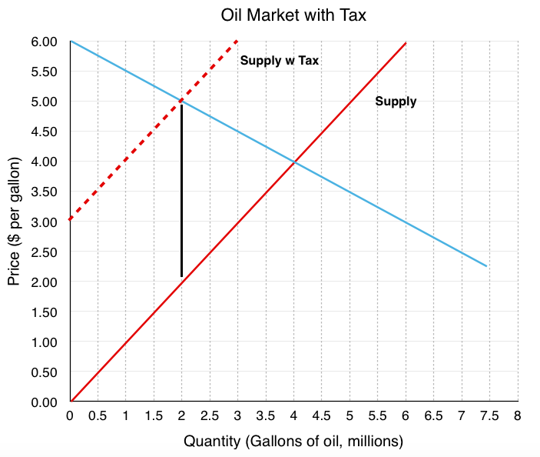
Example: Excise tax (producer pays)

Slide 26
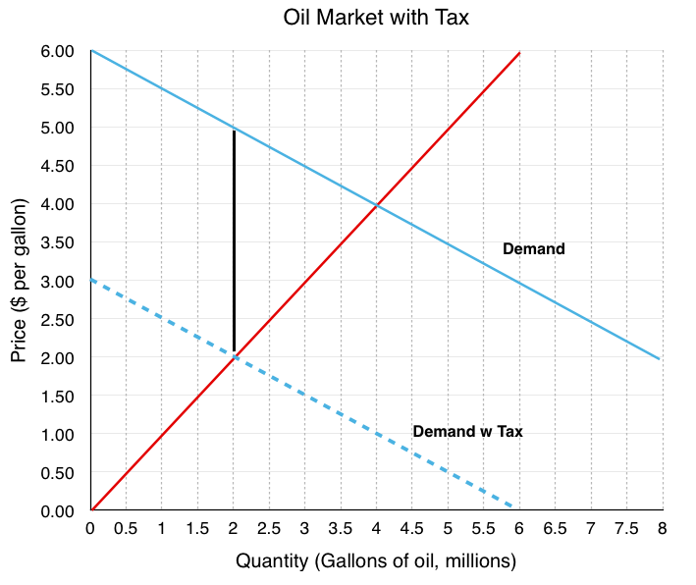
Example: Sales tax (buyer pays)

Slide 27
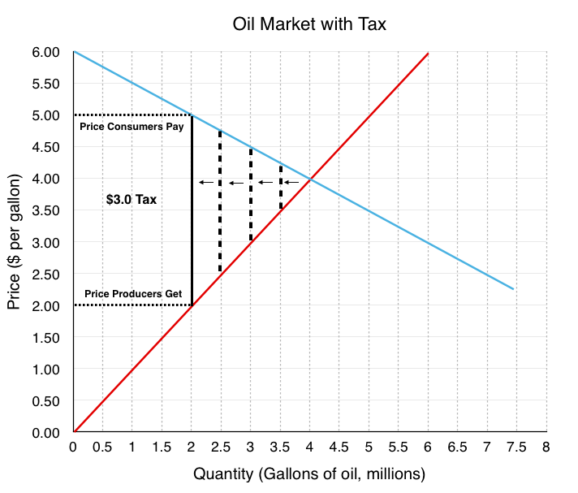
Notice a similarity?
Effective prices are the same in the two examples
One isn’t better or worse for consumers or producers… but let’s think more about that next.

Slide 28
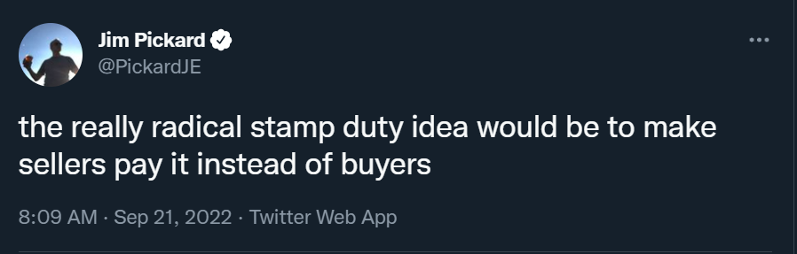

Slide 29
Alternative interpretation
Many firms act as platforms between two sides
Buyers and sellers via eBay, Amazon
Consumers and Advertisers via Google, Facebook
Posters and viewers on social media
The tax, then, might be a charge per transaction
This can be how the platform makes money
But these charges lower transactions (makes sense, but costly)

Slide 30
Welfare analysis
One way to think about demand curves: the height of the curve at each point is the willingness to pay for the Q^{th} unit.
Consumer surplus: the difference between willingness to pay and price actually paid.
Problem solving tip: CS is the area below demand and above the price.
Price
consumer surplus (CS)
P
D
Q
Quantity

Slide 31
Welfare analysis
One way to think about supply curves: the height of the curve at each point is the willingness to supply for the Q^{th} unit.
Producer surplus: the difference between price actually received and willingness to supply.
Problem solving tip: PS is the area above supply and below the price.
Price
S
P
producer surplus (PS)
Q
Quantity

Slide 32
Welfare analysis
Total surplus: the sum of consumer surplus and producer surplus.
This is economists’ main criterion for measuring market efficiency.
Equals: (willingness to pay) – (willingness to supply).
Problem solving tip: TS is the area above supply and below demand.
Market equilibrium (P*,Q*) is efficient: each and every socially desirable unit (willingness to pay greater than willingness to supply) is produced!
Price
CS
S
Total Surplus = CS + PS
P*
PS
D
Q*
Quantity

Slide 33
There is renewed interest among firms in welfare analysis
CS and PS are really the reason people use platforms
So making them work well is not just a civics question; it’s the source of platform value
Tension: revenue from these fees, versus discouraging transactions/benefit of the platform
When we think in detail about pricing, we’ll delve into solutions to this in more detail

Slide 34
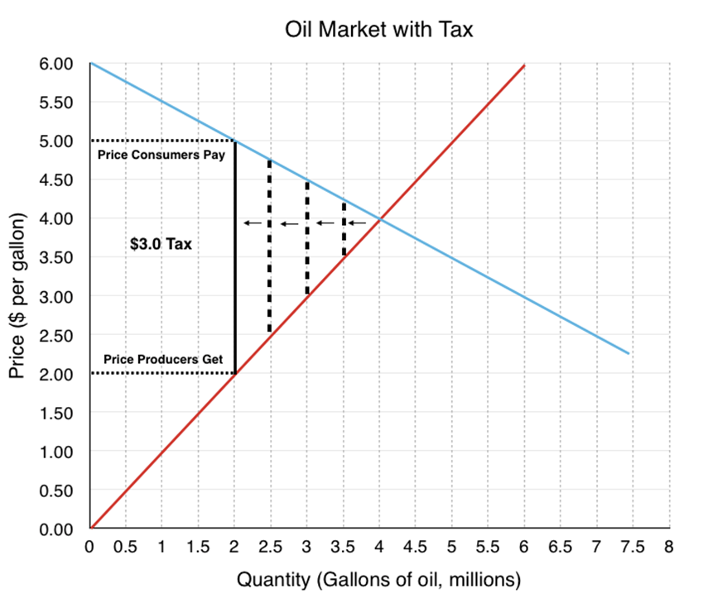
Platform value and fees/taxes
What is CS and PS before/after the tax/fee?
Harder one: Can you see tax revenue ($3 times number of gallons) on the graph?

Slide 35
Review: Supply and Demand
We can combine a MARKET demand curve with a market supply curve to understand prices and quantities in markets
How will they change when forces change?
How do policies impact markets?
We can use these same tools to understand the well being of participants in these markets
If the firm is a platform: how do decisions impact the platform?

Slide 36
Review: Supply and Demand
Concepts:
Demand curves and supply curves for a market
Market equilibrium ⟺ supply equals demand
Transactions create value: consumer and producer surplus
How do we use these ideas?
Demand and supply shifters change prices and quantities; formulate hypotheses and develop forecasts about price trends in competitive markets.
Predict implications of policy changes for market conditions. These “policy changes” might correspond to firm decisions when the firm is a platform

